Slide 1

Analysis based on Medical Overuse
Amber 王莺菲
Flora 张雨晨
Calista 韩雨遥

Slide 2
Subject
Microeconomic
Psychology
Calculus
Chemistry

Slide 3
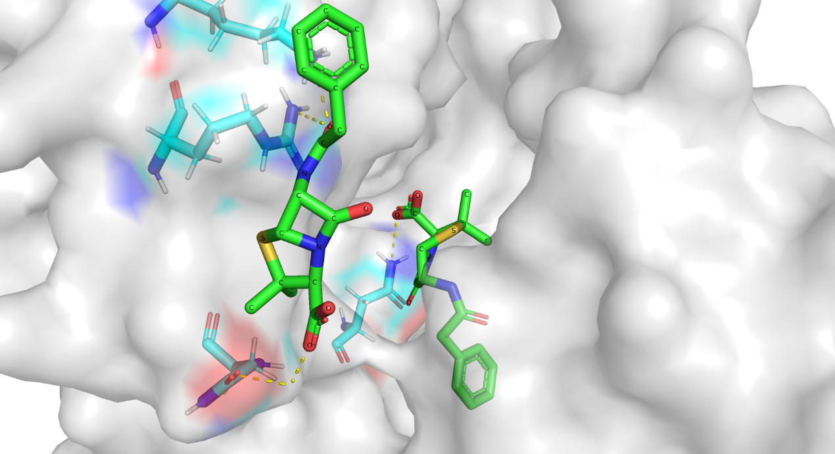
Background: world-wide situation
High-Income Countries (HICs)
Awareness is growing, especially in the last decade.
Despite this, overuse remains high:
In the U.S., caesarean sections rose from 21% (1996) to 31% (2006).
Use of CT and MRI scans grew 8–10% annually (1996–2010).
Initiatives to reduce overuse include:
The “Choosing Wisely®” campaign (U.S.)
The “do not do” list by NICE (UK)
Policies targeting low-value care in Australia
Impact remains limited; few studies show major reductions in overuse.
Low- and Middle-Income Countries (LMICs)
Overuse is rising sharply, especially for high-cost or incentivized services.
Tanzania: Caesarean delivery rates in low-risk births rose from 19% to 49% (2000–2011).
India: Reports of unnecessary hysterectomies and widespread overuse of drugs, scans, and procedures—often driven by financial incentives or corruption.
China: Reduced state funding led to hospitals overcharging for procedures, contributing to a 46% caesarean rate in some rural areas.
These trends seem recent and accelerating, but long-term data is limited.

Slide 4
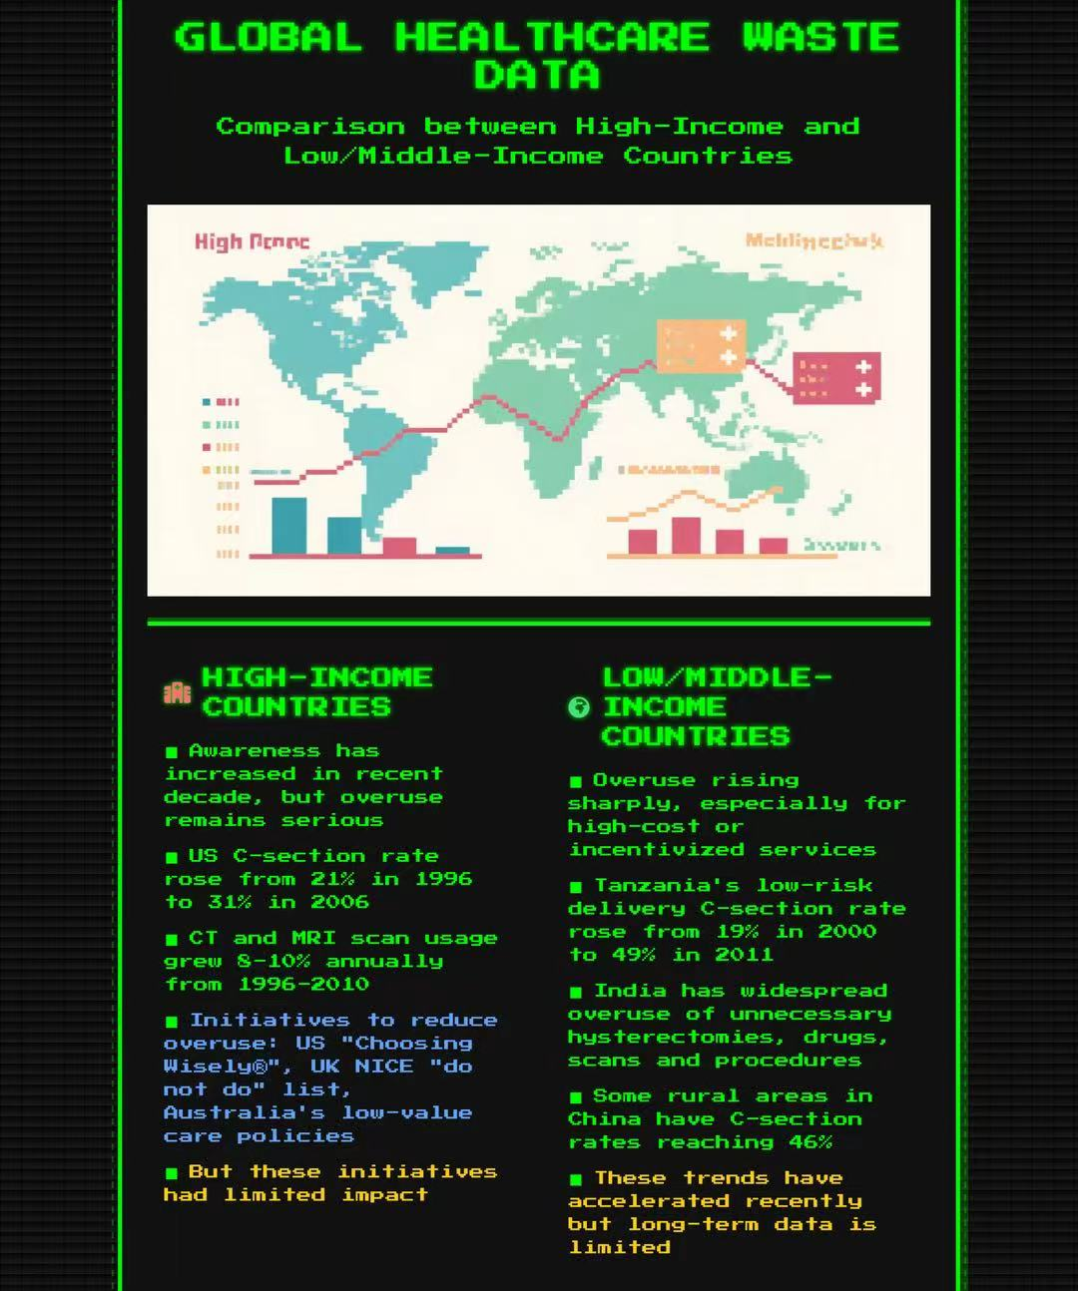
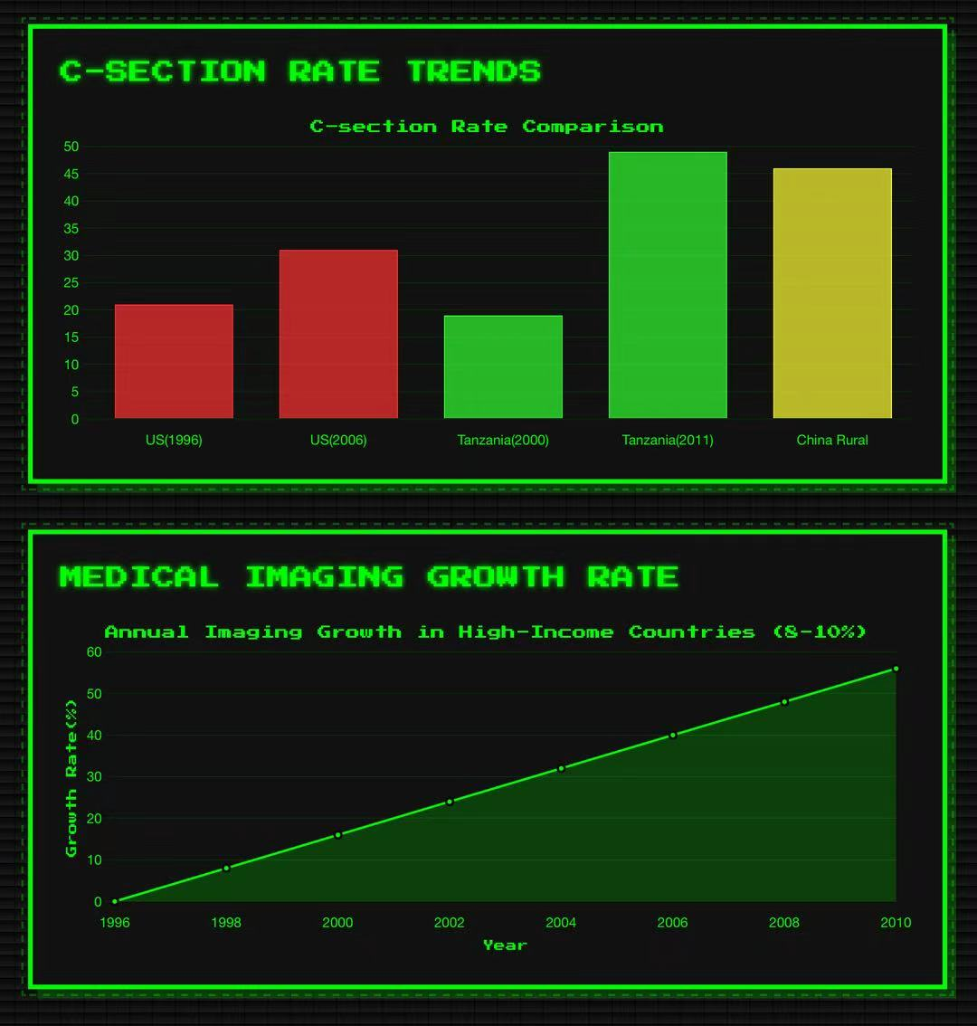

Slide 5
Proposal
We want to design A game about the situation Medical Overuse
The main idea of your project and explain
The final preparation is presented in the form of a board game and a survey report/synthesis. Medical overtreatment has become a hidden crisis in the global healthcare system. This project provides an interdisciplinary perspective to help the public understand how drug abuse induces drug-resistant bacteria, waste of resources, psychological dependence, and other issues to promote healthy drug use behaviors.

Slide 6
Outline
Week 1（5.19–5.25）
Clarify the research question, formulate the work plan, complete the preliminary literature review and model framework construction, and preliminarily organize the drug/psychological variables
Week 2（5.26–6.1）
Began to collect data: pharmacodynamic data, psychological research, drug resistance cases, etc. Preliminary modeling of calculus model, formula derivation + case verification The chemical part began to form a "drug-target-resistance" chain
Week 3（6.2–6.8）
Enter the game design stage (sketch design + basic rule formulation) Psychology + chemistry + mathematics knowledge into game mechanics Writing project paper: background + method + first draft of model
Week 4/（6.9–6.16）
Completion of the final report (including data analysis, model diagrams, and literature citations)
Complete board game art + test + manual production and prepare for the final presentation

Slide 7

Microeconomics
Beveridge Model: government provides and funds healthcare
  Berveridge Model is funded by public taxes and provides healthcare services directly through government-run hospitals and clinics
  由于资源预算制度、政府控制路径、绩效指标，过度医疗的动机较弱，但是也可能导致延迟治疗
Bismarck Model: employees and employers contribute to non-profit insurance funds.
  尽管有保险公司、监管机制（DRG、预算控制）的控制，很多私营医院仍追求利润。profit seeking for high-margin technologies是一个普遍存在的激励机制。
  竞争导致冗余
Compare and contrast different country’s medical system
Category:
  US (fee-for-service),
  United Kingdom, Canada, Spain, New Zealand(Beveridge Model),
  France/Germany (Bismarck Model),
  China Mainland (Hybrid model: Public hospitals + insurance + out-of-pocket),
  Taiwan (National Health Insurance Model)

Slide 8
Microeconomics
Hybrid Model: Combination of government funding, social health insurance, private insurance, and significant out-of-pocket payments by patients.
Complex regulatory environment; Uneven resource distribution; Insurance coverage expanding but incomplete
被过度医疗的原因：从供给来看，存在providers‘ profit-seeking motivation（Provider financial incentives）。从需求来看，治疗者普遍存在Low health literacy的问。 并且政府管理不严格
Fee for service:
Main Driver of Overuse: Payment is tied to procedures, not outcome
Physicians are financially motivated to do more procedures → medical overuse.
边际收益递增：每多做一项检查/治疗，医院和医生的收入增加
In conclusion, causal factors that could lead to medical resources overuse often includes incentive seeking for profit, Low health literacy and the loose government or insurance regulation

Slide 9

Psychology: Placebo effect and Epistemic Authority
Patients have an excessive need for medical treatment
For subjective descriptions, doctors tend to prescribe drugs ➡️ to patients, resulting in unnecessary drug use
The patient's trust in the doctor (authority) makes it impossible to judge whether there is a suspicion of excessive medical treatment in their own treatment
Evers, A. W. M., Colloca, L., Blease, C., Annoni, M., Atlas, L. Y., Benedetti, F., Bingel, U., Büchel, C., Carvalho, C., Colagiuri, B., Crum, A. J., Enck, P., Gaab, J., Geers, A. L., Howick, J., Jensen, K. B., Kirsch, I., Meissner, K., Napadow, V., ... Kelley, J. M. (2018). Implications of placebo and nocebo effects for clinical practice: Expert consensus. Psychotherapy and Psychosomatics, 87(4), 204–210.
Howe, L. C., Goyer, J. P., & Crum, A. J. (2017). Harnessing the placebo effect: Exploring the influence of physician characteristics on placebo response. Health Psychology, 36(11), 1074–1082.
Leibowitz, K. A., Hardebeck, E. J., Goyer, J. P., & Crum, A. J. (2019). The role of patient beliefs in open-label placebo effects. Health Psychology, 38(7), 613–622.
Kam-Hansen, S., Jakubowski, M., Kelley, J. M., Kirsch, I., Hoaglin, D. C., Kaptchuk, T. J., & Burstein, R. (2014). Altered placebo and drug labeling changes the outcome of episodic migraine attacks. Science Translational Medicine, 6(218), 218ra5.
Locher, C., Frey Nascimento, A., Kirsch, I., Kossowsky, J., Meyer, A., & Gaab, J. (2017). Is the rationale more important than deception? A randomized controlled trial of open-label placebo analgesia. Pain, 158(12), 2320–2328.

Slide 10





Calculus: PKPD modeling and derivative
可以通过PK-PD模型得效用和血药浓度，效用和时间的关系
假设药物效用随着浓度升高而递减，应该期望看到导数越来越小
假设人得体重约为62kg，每隔6小时服用布洛芬和地西泮，4小时注射青霉素
每次药物浓度：计算服药时间前的药效+服药后的药效
药效模型PD
药物动力学模型PK
D: 剂量
F: 生物利用度
t: 半衰期
k: 速率常数ln2/t
Emax 最大药效
EC50：达到Emax一半效果时的浓度
V：药物在体内的分布空间大小
W：体重
[1]Lee, J Jack et al. “Emax model and interaction index for assessing drug interaction in combination studies.” Frontiers in bioscience (Elite edition) vol. 2,2 582-601. 1 Jan. 2010, doi:10.2741/e116
[2]Navarro, Danielle. 2024. “Notes on the Emax Model.” January 9, 2024. https://blog.djnavarro.net/posts/2024-01-09_emax-models/
[3]Meibohm, B, and H Derendorf. “Basic concepts of pharmacokinetic/pharmacodynamic (PK/PD) modelling.” International journal of clinical pharmacology and therapeutics vol. 35,10 (1997): 401-13..

Slide 11
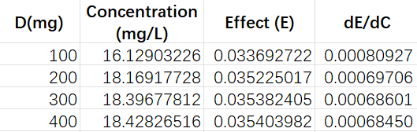
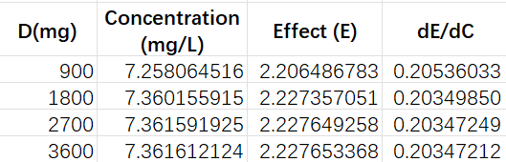
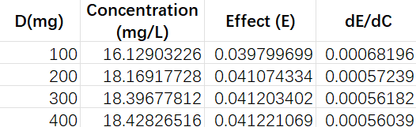
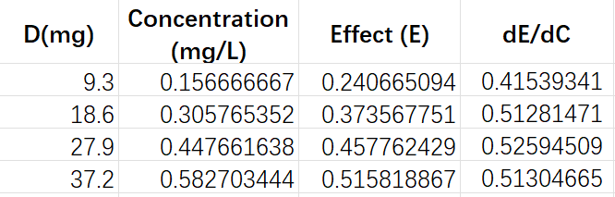
Calculus
Penicillin G
ibuprofen dental pain
ibuprofen of antipyretic
diazepam

Slide 12

Chemistry
细菌感染和penicillin：
病理：细菌侵染宿主细胞，攻击免疫系统，产出毒性。
药物机理: 结合pbp，一个可以合成细胞壁（peptidoglycan）的酶，结合它会破坏细菌细胞壁导致细菌死亡。
耐药性危害：盘尼西林耐药时盘尼西林和细菌结合能力下降
感冒和布洛芬：
病理：病毒感染呼吸道，带来咳嗽，嗓子痛等症状。
药物机理:通过 可逆性抑制 COX-2 的活性，阻止花生四烯酸转化为前列腺素。前列腺素是炎症、发热、疼痛反应的主要介质
耐药性危害：off target结合COX1。COX2在炎症时大量表达，介导疼痛、发热，但是COX1作为一种酶有保护胃壁、防止溃疡的作用。如果和COX1结合可能会损伤胃黏膜。布洛芬对COX1和COX2的interaction相似，结合强度相似（binding affinity），所以过度使用时布洛芬会去和结构类似，结合强度类似的COX1结合
细菌感染和penicillin：
病理：中枢神经系统的过度觉醒、生物节律的紊乱，以及压力和焦虑等心理因素。长期失眠可能会导致大脑代谢和内分泌功能的改变。
药物机理：激活GABAA受体，增强氯离子通过的频率，膜电位超极化（hyperpolarization），抑制action potential的信号传导
耐药性危害：off target结合GABAA alpha5, 5亚型主要分布在海马体，参与认知与记忆功能
Penicillin: bacteria infection
Ibuprofen: common cold
Diazepam: insomniac
我们用binding affinity(ΔG)代表结合强度，结合强度越强药效越好。
现在研究的药物如果过度使用主要有两种危害。一个是产生耐药性，使得结合强度变低。另一个是off-target effect，代表药物和不是理想的靶点结合，可能抑制别的机理产生副作用。

Slide 13
Reference
[1] Shrank, William H et al. “Waste in the US Health Care System: Estimated Costs and Potential for Savings.” JAMA vol. 322,15 (2019): 1501-1509. doi:10.1001/jama.2019.13978
[2] Brownlee, Shannon et al. “Evidence for overuse of medical services around the world.” Lancet (London, England) vol. 390,10090 (2017): 156-168. doi:10.1016/S0140-6736(16)32585-5
[3] Boris Polanco, Ana Oña, Armin Gemperli, Diana Pacheco Barzallo, Excess healthcare utilization and costs linked to chronic conditions: a comparative study of nine European countries, European Journal of Public Health, Volume 35, Issue 2, April 2025, Pages 216–227,
[4] Explaining Marginal Benefits to Patients, When “Marginal” Means Additional but Not Necessarily Small Free Thomas J. SmithCorresponding Author; Bruce E. Hillner
[5] Bar-Tal, Y., Brycz, H., Dolinska, B., & Dolinski, D. (2019). When saying that you are biased means that you are accurate? The moderating effect of cognitive structuring on the relationship between metacognitive self and confirmation bias use. Current Psychology, 38, 1706-1712.
[6] Bettinghaus, E., Miller, G., & Steinfatt, T. (1970). Source evaluation, syllogistic content, and judgments of logical validity by high- and low-dogmatic persons. Journal of Personality and Social Psychology, 16(2), 238-244.
[7] Boucher, L. M. (2014). Individual differences influence the degree of source expertise bias in syllogistic reasoning [Master's thesis, Carleton University]. Carleton University.
[8] Soni, Jyoti, Sristi Sinha, and Rajesh Pandey. "Understanding Bacterial Pathogenicity: A Closer Look at the Journey of Harmful Microbes." Frontiers in Microbiology, vol. 15, 2024,
[9] Hartman, B. J., and A. Tomasz. "Low-affinity Penicillin-binding Protein Associated with Beta-lactam Resistance in Staphylococcus aureus." Journal of Bacteriology, vol. 158, no. 2, 1984, pp. 513–516.
[10] Kumar, Gaurav, et al. “Penicillin Binding Proteins and β-Lactamases of Mycobacterium tuberculosis: Reexamination of the Historical Paradigm.” mSphere, vol. 7, no. 1, 2022, e0003922,

Slide 14
Reference
[11] Lai, Christopher K.C., et al. “Overcoming the Rising Incidence and Evolving Mechanisms of Antibiotic Resistance by Novel Drug Delivery Approaches – An Overview.” Advanced Drug Delivery Reviews, vol. 181, 2022, 114078, ISSN 0169-409X,
[12] Katz, Sophie. "Common Cold." MSD Manual Professional Edition, 2024. Accessed 4 June 2025.
[13] Möhler, Hanns. “The GABA System in Anxiety and Depression and Its Therapeutic Potential.” Neuropharmacology, vol. 62, no. 1, 2012, pp. 42-53,
[14] Rudolph, Uwe, and Frédéric Knoflach. “Beyond Classical Benzodiazepines: Novel Therapeutic Potential of GABAA Receptor Subtypes.” Nature Reviews Drug Discovery, vol. 10, no. 9, 2011, pp. 685–697
[15] Schroeder, Steven A., and William Frist. "Phasing Out Fee-for-Service Payment." New England Journal of Medicine, vol. 368, no. 21, 2013, pp. 2029–2032. Massachusetts Medical Society,
[16] Wallace, Lorraine S. “A View of Health Care Around the World.” Annals of Family Medicine, vol. 11, no. 1, 2013, p. 84.
[17] Vera Whole Health. “Global Healthcare: 4 Major National Models and How They Work.” Vera Whole Health, 10 Sept. 2020.
[18] Saini, Vikas, et al. “Addressing Overuse and Underuse Around the World.” Lancet, vol. 390, no. 10090, 2017, pp. 105–107
[19] Kozuń-Cieślak, Grażyna, and Pavel Zdrazil. “Efficiency of Healthcare Systems in the European Union States – Who Performs Better – Bismarckians or Beveridgeans?” European Research Studies Journal, vol. 24, special issue 4, 2021, pp. 397–411.
[20] Zhang, Yi, et al. “When More is Less: What Explains the Overuse of Health Care Services in China?” Social Science & Medicine, vol. 232, 2019, pp. 17–24
[21] Yip, Winnie Chi-Man, et al. “Early Appraisal of China's Huge and Complex Health-care Reforms.” The Lancet
[22] Trocóniz, I.F., Armenteros, S., Planelles, M.V. et al. Pharmacokinetic-Pharmacodynamic Modelling of the Antipyretic Effect of Two Oral Formulations of Ibuprofen. Clin Pharmacokinet 38, 505–518 (2000). https://doi.org/10.2165/00003088-200038060-00004
[23] Moghadamnia, Yasaman et al. “New formulation of ibuprofen on absorption-rate: A comparative bioavailability study in healthy volunteers.” Caspian journal of internal medicine vol. 10,2 (2019): 150-155. doi:10.22088/cjim.10.2.150
[24] Dewland, Peter M et al. “Bioavailability of ibuprofen following oral administration of standard ibuprofen, sodium ibuprofen or ibuprofen acid incorporating poloxamer in healthy volunteers.” BMC clinical pharmacology vol. 9 19. 4 Dec. 2009
[25] Hattrem, Magnus N et al. “The Relative Bioavailability of Ibuprofen After Administration With a Novel Soft Chewable Drug Formulation.” Clinical pharmacology in drug development vol. 7,2 (2018): 168-176. doi:10.1002/cpdd.357

